Slide 1
Docsis
Basics - Outlook - Discussion
Arbnor Gashi
Prishtine, 26. Mai 2017

Slide 2
AGENDA
AlbiSMART
Basics of DOCSIS
Docsis 3.0
Introduction Docsis 3.1
Cisco CMTS Configuration
Q&A
f
Sonstiges

Slide 3
doninet
dotnet
eagle
egc
elcom
fitnes
galaktika
gashi
happy
herc
ictnet
jabnet
jn
kadrianet
kikinet
kogroup
kosovanet
kumanova
looksgym
maxtv
necinet
normann
planet
schoefisch
shqiponja
smart
speednet
telekomi
telkos
tvm
tvnet
vision
vitnet
wirnet
4net
ag
airnet
albalink
albinet
albonet
anet
apt
ardian
artinet
artvision
babinet
belsh
best
besttv
bledi
Connectisp
crazynet

Slide 4
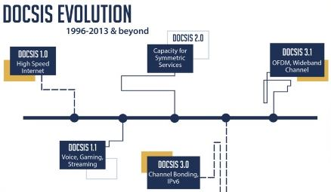
DOCSIS – Data over Cable Services Interface Specification
CableLabs (certification)
Standarts – Multiple vendors to develop interoperable devices
Cable telephones + data transmissions
DOCSIS 1.0 – 1997
EuroDOCSIS 1.0 (1999 – June 2000) –
DOCSIS 1.0
– High Speed Internet connection, CoS
• DOCSIS 1.1
– Voice , QoS-Service Flow concept, BPI+ - Certificates 8-tap
• DOCSIS 2.0
– No Changes to DS, PHY – MAC CHANGE – up to QAM64 , FEC, Interleave- PreEqulaization 24 taps
• DOCSIS 3.0
– Channel Bonding,IPv6, Multicast, Compete FTTx
• DOCSIS 3.1
– OFDM+LDPC, Wideband Channel, Frequency range increased ( Upstream -204 , DS 1218 - 1794Mhz
Notes:
The introduction of cable data service to cable television subscribers is one of the most successful deployment stories in the history of Internet. – MSO – Multiple System Operators – transformed themselves from being providers of entertainment video into being most popular of both entertainment and affordable, broadband data services.
-

Slide 6
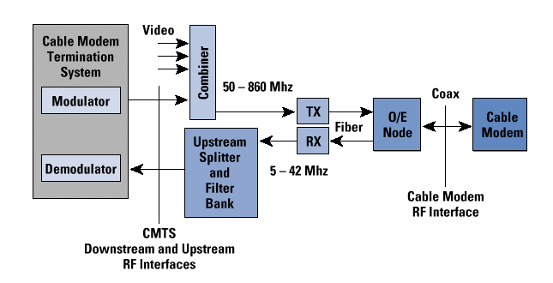
DOCSIS 2.0 Overview
CMTS & CM ( Routed – Bridge )
Distribution network is optical all the way to a specific neighbourhood- A FN (fibernode) converts optical signal to an electrical signal over coax serves 500 homes.
A typical DOCSIS configuration:
-> Single DS channel is split to 4 FN and serves 200 homes – at least 1 US)

Slide 7
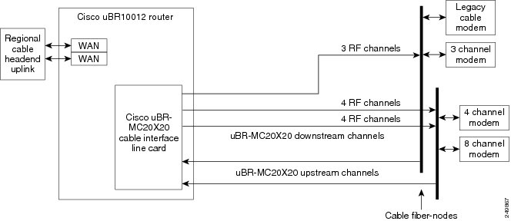
Integrated CMTS
One Linecard – 20Downstream and 20 Upstreams
One/8 Downstream – few upstreams

Slide 8
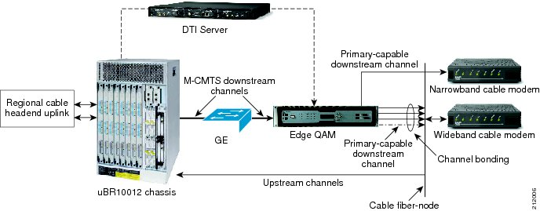
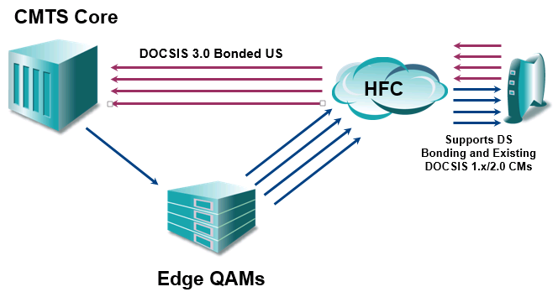
Modular CMTS
Independent scalability
EdgeQAM-DS Modulation
DTIServer
StrictTiming–Core-DS-US
EdgeResourseManager

Slide 9
M-CMTS Komponenten
EQAM (Edge QAM device):System with multiple Gigabit Ethernet interfaces on the input side and multiple QAM modulators and upconverters on the output side
M-CMTS Core:Includes the DS MAC and all initialization and DOCSIS-related operational software
DTI (DOCSIS Timing Interface) Server:Provides a common frequency of 10.24 MHz as well as a DOCSIS time-stamp for all M-CMTS elements
ERM (Edge Resource Manager): Manages the dynamic allocation of the QAM channel resources to the CMTS MAC domains

Slide 10
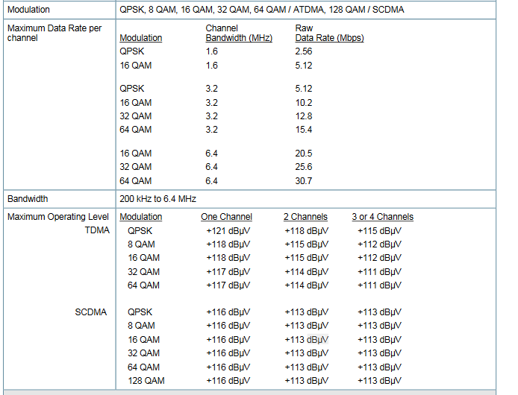
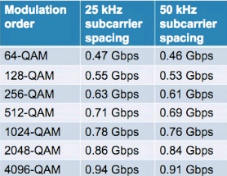
Bandwidth in Detail
DS vs. US ( Ex.5xOFDM–2xOFDMA)

Slide 11
Initialize a Modem
“Ranging”
Scannen and Synchronisieren
Scan Downstreams Channels (SYNC-200msec) (ChannelWidth,Modulation-Frequency)
Communication of upstream parameters (UCD2s) + MAP
Bandwidth,ModProf,Freq,Distance,TXPower,TDMA
Ranging (Pegel-Abgleich) & Ranging Complete
“Registierung”
Authentication(MAC)
IP Connectivity ( Management)
Set up v. Time of Day (ToD - Logs)
Communication of operations Parameter – TFTP
Register with CMTS – Reg. Complete CPE Registration & Operational
Notes:
When we plug a CM into the network, it must establish two way communication with the cmts before it can work properly. As we have seen CM and CMTS use two channels to communicate with each other. The CMTS uses the downstream channel to send data to all CMs on the network.
When a CM wants to receive the data, it just has to tune in to a EuroDOCSIS downstream.
To send data to the CMTS , the CM has to use an upstream channel. This is more challenging than finding a downstream. The CM does not know the center frequency or bandwidth of an existing upstream channel. It also doesn‘t know how far it is from the CMTS, which has an impact on the transmit power level it has to use. Then the impact on the time syncronisation between CM and CMTS. And last but not least, the CM cannot transmit whenever it wants. It‘s TDMA and an upstream channel is shared by multiple modems. If two modems transmit at the same time, their signals will collide. 1. Scan of a Valid EuroDOCSIS downstream channel Once the modem has found a valid EuroDOCSIS downstream channel, it can start ist process prior to initial ranging. This process roughly consist of three parts: Syncronization, obtatin the upstream parameters and waiting for a map. This threee actions must be executed successfully before the modem can move on to initial ranging.

Slide 12
Cablemodem- Installation - Ranging
CM dergon ne US u. merr Feedback nga DS
CM kerkon DS und pranon info per US

Slide 13
Cable modem-Installation - Ranging
CM pershtat parametrat derisa cmts I verteton ato
CMTS instrukston CM per ndryshim te nivelit te sinjalit

Slide 14
Registration
CMTS forwards requests from CM to server (DHCP, ToD)
CM asks IP addresses (required for registration)
CM gets confirmation and configuration details from servers

Slide 15
DOCSIS 3.0 Registration Diagram
WCM acquires QAM/FEC lock of DOCSIS DS channel
SYNC, UCD, MAP messages
WCM performs usual US channel selection, but does not start initial ranging
MDD message
WCM performs bonded service group selection, and indicates via initial ranging
B-INIT-RNG-REQ message
Usual DOCSIS initial ranging sequence
WCM transitions to ranging station maintenance as usual
DHCP DISCOVER packet
DHCP OFFER packet
DHCP REQUEST packet
DHCP RESPONSE packet
TOD Request/Response messages
TFTP Request/Response messages
REG-REQ message
WCM provides Rx-Chan(s)-Prof
REG-RSP message
WCM receives Rx-Chan(s)-Config
REG-ACK message
WCM confirms all Rx Channels
Usual BPI init. If configured

Slide 16
Equalization - Pre-equalization (Equalisation- Pre-EQ
The cable modem sends a "Ranging Bursts" of at least 34 bytes. In the CMTS, these are received and echoes (microreflections) are detected. From this, coefficients are calculated, these are returned to the cable modem and stored. On the next transmission from the modem the signal is changed by means of coefficients so that the data arrives echofrei with the CMTS this time.
Docsis 1.0 Normally without equalization(event optional)
Docsis 1.1 8-stage equalization
Docsis 2.0 24-stage equalization

Slide 17
Upstream Adaptive Equalization Example
Upstream 6.4 MHz bandwidth 64-QAM signal
Before adaptive equalization:
Channel skew causes FEC errors that can be remedied up to a rate of approximately 7000 errored codewords per second (232 bytes per codeword). The measured mer (SNR) of the CMTS was 23 dB.
After adaptive equalization:
DOCSIS 2.0's 24-tap adaptive equalization -extremely pre-equalization in the modem allows to compensate almost all channel obliquities (without changing the digital channel strength). Result: no FEC errors to be corrected and the upstream MER (SNR) rises to ~36 dB
Notes:
This slide illustrates an example of upstream pre-equalization in action. To demonstrate the performance of DOCSIS 2.0’s 24-tap pre-equalization, a cable modem was set up to transmit a 6.4 MHz-wide 64-QAM signal at a center frequency of 48 MHz. This frequency forced the signal through the rolloff area of the cable modem’s internal low pass filter, causing substantial in-channel tilt. The upper photo shows the 64-QAM signal as received by the CMTS without adaptive pre-equalization, and the lower photo shows the same signal at the CMTS input after the modem’s adaptive pre-equalization was turned on.
Before adaptive equalization: The in-channel tilt caused correctable FEC errors to increment at a rate of about 7000 errored codewords per second (232 bytes per codeword). The CMTS’s reported upstream unequalized MER (“SNR”) was 23 dB.
After adaptive equalization: The modem’s 24-tap pre-equalizer was able to compensate for nearly all of the in-channel tilt (with no change in digital channel power). The result: No correctable or uncorrectable FEC errors and the CMTS’s reported upstream unequalized MER increased to ~36 dB.

Slide 18
DOCSIS 3.0 Features
MAC Layer
Downstream Channel Bonding
Upstream Channel Bonding
Network Layer
IPv6 support
IP Multicast
Security
Certificate Revocation Management
Runtime SW / Config validation
- Early Authentication & Encryption + AES
TFTP Proxy
Network Management
Diagnostic Log (Flaplist)
Extension of Internet Protocol Data Records (IPDR) usage
Capacity management
Enhanced signal quality monitoring
Physical Layer
Switch-able 5-42 MHz, 5-65 MHz, or 5-85 MHz US band
Notes:
New technologies are being pursued to address the DS bottleneck conundrum.
DOCSIS 3.0 uses a channel bonding technique to achieve higher capacity links, enable faster high speed data (HSD) service, and provide M x N MAC domains to enable video over IP solutions.
The idea of multiple grants per request or outstanding requests with DOCSIS 3.0 is also a good idea for US speed, but still doesn't fix the CPU issue on the CM.
The modular CMTS (M-CMTS) architecture is promoted to achieve better DOCSIS economics, lower cost DS PHY, and de-couple DS and US ports. One day we may see fiber optic nodes with DOCSIS physical layer chips embedded so we can use ingress cancellation at the node, digital links from the node back to the headend without the need to amplify, and no more laser clipping. Of course, this means all traffic needs to be DOCSIS-based on the US!
The integrated-CMTS idea is a way to use “off-the-shelf” external QAM boxes and the existing CMTS just for US connectivity. This allows return on invest and no “fork-lift” upgrades of the CMST chassis and/or limited cabling changes.

Slide 19
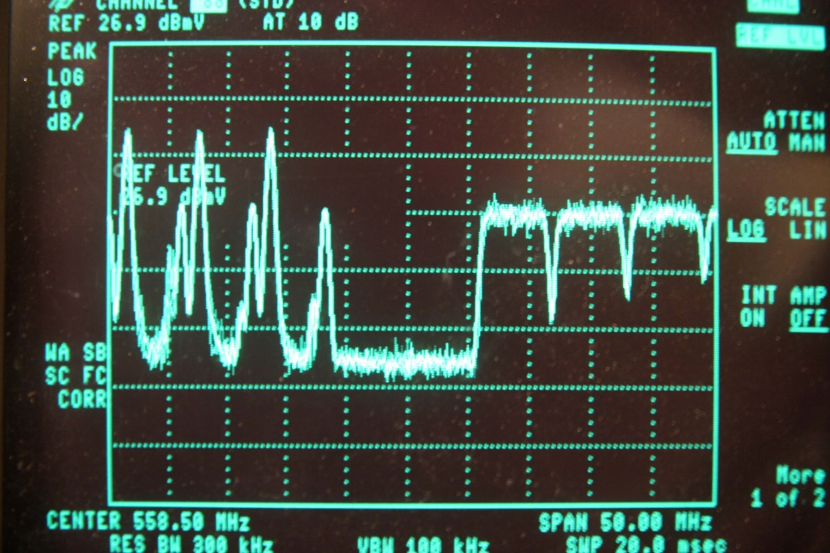
Channel Bonding
In summary, channel bonding means that data is transmitted from and / or to the KMs when using different individual RF channels instead of a single one.
The channels are not physically packed into a single giant digitally modulated signal, the bonding is logically structured.
With DOCSIS 1.x & 2.0, data is transmitted to modems using one channel
With DOCSIS 3.0, data is transmitted to modems using multiple channels

Slide 20
DOCSIS 3.0 - DS Channel Bonding
Downstream Bonding - Features
Bonding of at least 4 QAM channels (up to 24 and more are possible)
allows > 300 Mbps
Based on Docsis 2.0
Seamless transition from Docsis 1.x / 2.0
M-CMTS concept for the first time
Use of EdgeQAMs
Flexible use of the frequency spectrum

Slide 21
DOCSIS 3.0 - US Channel Bonding
Upstream Bonding - Features
Minimum of 4 channels
Enables more than 50 Mbps
Based on Docsis 2.0
No changes in modulations (up to QAM64 in return)

Slide 24
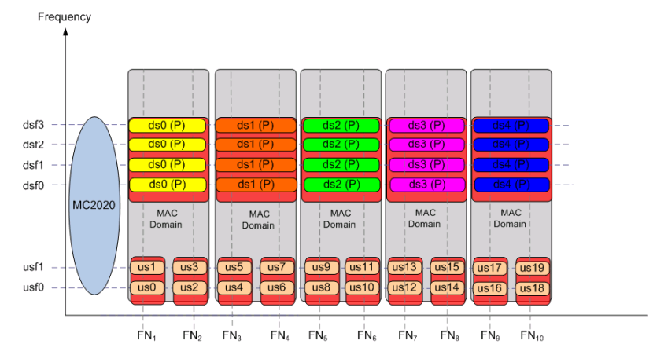
Case Studies/ Architecture Ideas
Case Study 1

Slide 25
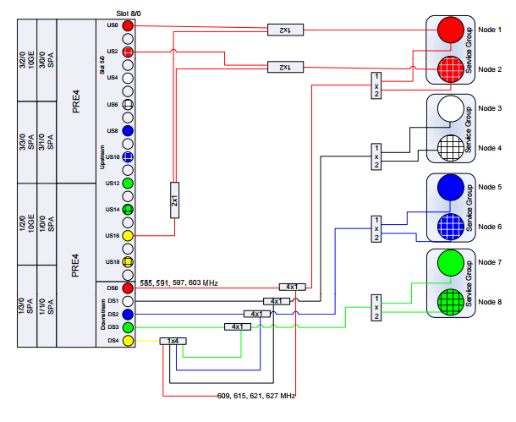
RF Spanning Option with RF Spanning Option with MC2020V MC2020V

Slide 26
IPv6 in DOCSIS 3.0/ DOCSIS 3.x Reference Architektur

Slide 27
IPv6 in Cable Networks

Slide 29
dOCSIS 3.1 - GENERAL
In the version DOCSIS 2.0, the subscriber is permanently assigned a transmission channel. The bandwidth is thus not scalable and expandable. A single channel has a data rate of approximately 50 Mbit / s. In practice, one or two subscribers who make high-rate downloads can limit other users in their data rate.
The latest version of DOCSIS 3.0 supports channel bundling, as well as IPv6, Quality of Service (QoS), Internet TV (IPTV) and IP multicast. The channel bundling works dynamically and distributes the data to the available channels. In total, 16 channels are available for the downstream, and, if necessary, even more, to which the data can be distributed. This should not create any bottlenecks because the data rate of 400 Mbit / s for 8 channels and the 800 Mb / s for 16 channels. Upstream of the DOCSIS standard, there are three 6.4 MHz wide channels, namely in the lower VHF range on the TV channels 2, 3 and 4 in the frequency range between 47 MHz and 68 MHz. The data rate can be 100 Mbit / s and higher. The 16 channels for the downstream are in the middle UHF range between 630 MHz and 862 MHz.

Slide 30
dOCSIS 3.1
DOCSIS 3.1 has a completely new physical layer for the data transmission system via HFC networks based on Orthogonal Frequency Division Multiplex (OFDM) and a global standard. • Comprehensive co-existence with DOCSIS signals from previous variants ensures backwards compatibility, also with the variants of EuroDOCSIS.

Slide 31
Docsis 3.1 - Downstream
Up to 10 Gbps downstream
Supports Downstream Channel Bonding
Use of Sub-Carrier (20-50 kHz)
Channel Width: 24 MHz to 192 MHz (OFDM)
Modulation: to QAM 4096
Bandwidth up to 1218 MHz or later 1794 MHz

Slide 32
TECHNICOLOR – MARKET TRENDS

Slide 33
TECHNICOLOR – MARKET TRENDS

Slide 34
TECHNICOLOR – MARKET TRENDS

Slide 35
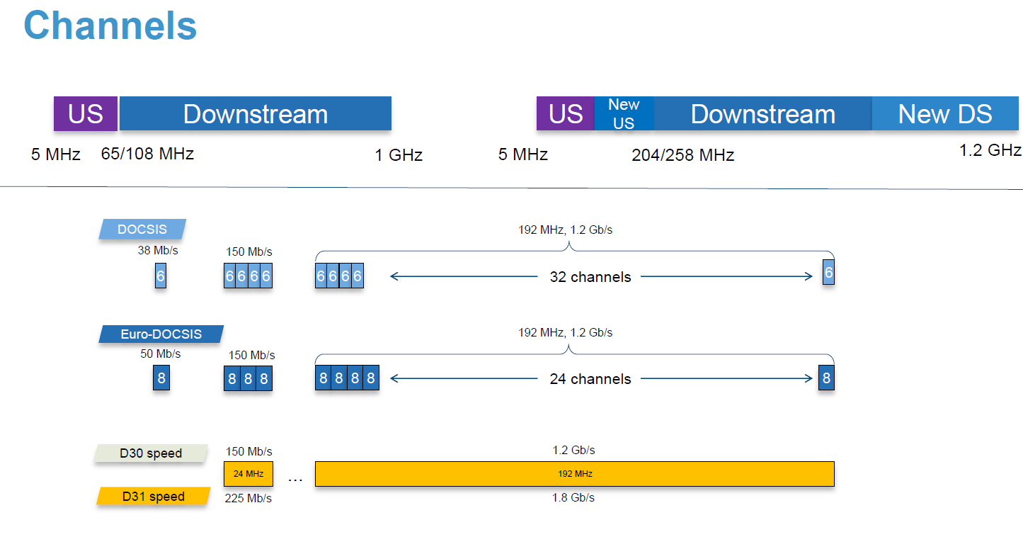
TECHNICOLOR – MARKET TRENDS

Slide 38
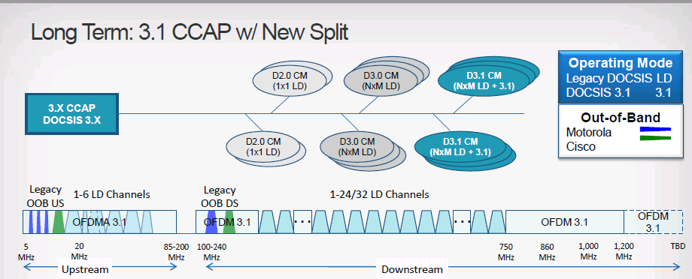
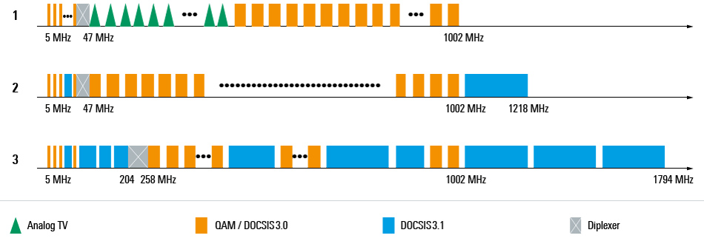

Slide 40
TECHNICOLOR – MARKET TRENDS

Slide 41
TECHNICOLOR – MARKET TRENDS

Slide 42
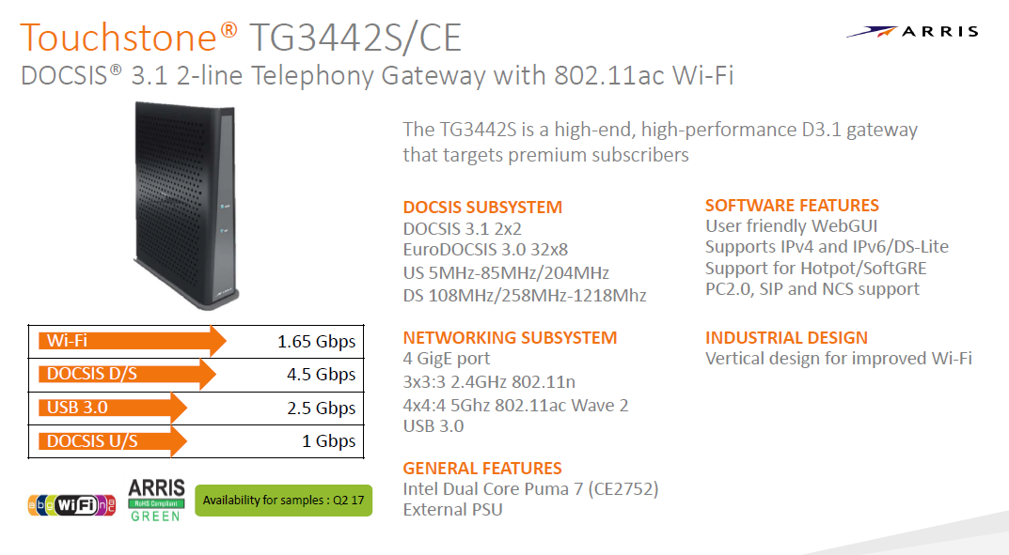
TECHNICOLOR – MARKET TRENDS

Slide 43
TECHNICOLOR – MARKET TRENDS

Slide 44
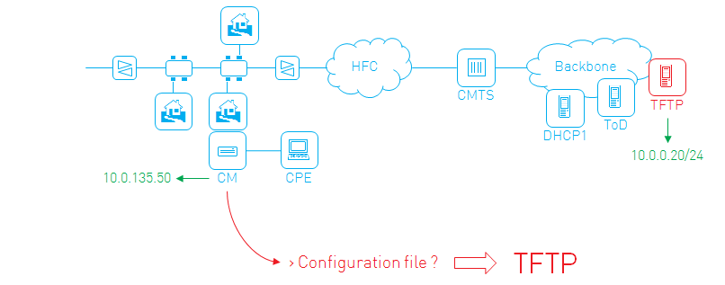
Configuration Files
Network Access
QoS - Bandwidth Limitiation
CPE Limitation
Security (MIC)
Software upgrade
SNMP access configuration
SNMP Mib Objects
Vendor specific parameters
Structure ( Binary-Each parameter encoded as TLV)
Nachfolgend:
Übersicht & Details DOCSIS 3.1
Notes:
Skip unknown TLV – Type and Length are 1 byte value more .
Config file is sequence of TLVs .
When the CM downloaded ist config file, it start reading at the first byte. This is the type of the first parameter in the config file. The next byte is the length field of the parameter, it tells the CM the number of bytes the values is composed of. The CM reads that many bytes to obtain the value. The byte after the values is the type of the next parameter and so one.
Some parameters are composed of sub-tlvs. This simply means that their value field is another sequence of TLV

Slide 45
Configuration Files Example
(TFTPDownload-CfgFile) 03 01 01 04 19 01 01 01 02 04 00 98 96 80 03 04 00 26 26 a0 12 01 05
Config file
03 01 01 = Network Access is ON
04 19 = Cos Encoding
01 01 01 = Class id 1
02 04 00 98 96 80 = Max DS rate is 10000000
03 04 00 26 25 a0 = Max US rate is 2500000
….
12 01 05 = Max number of CPE 5
Nachfolgend:
Übersicht & Details DOCSIS 3.1
Notes:
Skip unknown TLV – Type and Length are 1 byte value more .
Config file is sequence of TLVs .
When the CM downloaded ist config file, it start reading at the first byte. This is the type of the first parameter in the config file. The next byte is the length field of the parameter, it tells the CM the number of bytes the values is composed of. The CM reads that many bytes to obtain the value. The byte after the values is the type of the next parameter and so one.
Some parameters are composed of sub-tlvs. This simply means that their value field is another sequence of TLV

Slide 46
Config Files types
1.0 Config file
Contains Class-of-Service
EuroDOCSIS 1.0, no guarente of services – Only Best effort
1.0, 1.1 , 2.0 …
1.1 Config File
Contains Service Flows
Enables QoS, Bpi+, SNMPv3…
EuroDOCSIS 1.1 and nigher
Guarentees on transmission rates, delay etc.
VoIP, Video-over-IP
Nachfolgend:
Übersicht & Details DOCSIS 3.1
Notes:
Skip unknown TLV – Type and Length are 1 byte value more .
Config file is sequence of TLVs .
When the CM downloaded ist config file, it start reading at the first byte. This is the type of the first parameter in the config file. The next byte is the length field of the parameter, it tells the CM the number of bytes the values is composed of. The CM reads that many bytes to obtain the value. The byte after the values is the type of the next parameter and so one.
Some parameters are composed of sub-tlvs. This simply means that their value field is another sequence of TLV

Slide 47
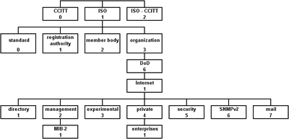
Management
SNMP–Management Protocol for Equipment-Client/Server-UDP
MIBS – Management Information Base - Is a description that contains definitions of management information that can be used to remotely monitor, configure, and control a device connected to a network. Mib tree - The MIB when processing an SNMP request
Nachfolgend:
Übersicht & Details DOCSIS 3.1
Notes:
Mibs can be put into the CM cfg File
Community string
Simple Network Management Protocol
(Weitergeleitet von SNMP)
SNMP (Simple Network Management Protocol)Familie:InternetprotokollfamilieEinsatzgebiet:NetzwerkverwaltungNeueste Version:SNMPv3Ports:161/UDP 162/UDP (Trap)SNMP im TCP/IP-Protokollstapel:AnwendungSNMPTransportUDPInternetIP (IPv4, IPv6)NetzzugangEthernetToken BusToken RingFDDI…Standards:RFC 1157 (SNMP, 1990) RFC 3410 ff (SNMPv3, 2002) (siehe Text)
Überwachung der Netzwerkkomponenten von der Managementkonsole aus
Das Simple Network Management Protocol (SNMP; deutsch Einfaches Netzwerkverwaltungsprotokoll) ist ein Netzwerkprotokoll, das von der IETF entwickelt wurde, um Netzwerkelemente (z. B. Router, Server, Switches, Drucker, Computer usw.) von einer zentralen Station aus überwachen und steuern zu können. Das Protokoll regelt dabei die Kommunikation zwischen den überwachten Geräten und der Überwachungsstation. SNMP beschreibt den Aufbau der Datenpakete, die gesendet werden können, und den Kommunikationsablauf. Es wurde dabei so ausgelegt, dass jedes netzwerkfähige Gerät mit in die Überwachung aufgenommen werden kann. Zu den Aufgaben des Netzwerkmanagements, die mit SNMP möglich sind, zählen:

Slide 48
SNMP Access
snmpset -v1 -c remote 172.22.8.24 .1.3.6.1.4.1.2863.205.10.1.30.100.0 i 1
snmpwalk -v1 -c public 172.22.8.3 1.3.6.1.2.1.69.1.4.5.0
snmpset -v1 -c remote 172.22.8.24 DISMAN-EVENT-MIB::sysUpTimeInstance

Slide 49
NMAccess Mode Example
SNMPServer: 10.0.0.24 Community: 7c0m1ab5 CM IP: 10.0.135.36 may only accept snmp messages via the rf interface
docsDevNmAccessIp.1 10.0.0.24
docsDevNmAccessIpMask.1 255.255.255.255
docsDevNmAccessCommunity.1 7c0m1ab5
docsDevNmAccessControl.1 readWriteWithTraps(5)
docsDevNmAccessInterfaces.1 (40)hex=(0 1 0 0 0 0) Ethernet , CatTV Mac, USB …
docsDevNmAccessStatus.1 CreateAndGo(4) //( CreateAndWait(5) object ( conflict) Table (Zeile) | Ip | mask | community | control | interface | status| active |
Nachfolgend:
Übersicht & Details DOCSIS 3.1

Slide 50
Software upgrade
Bug Fixing
New Features
Performance tuning
Remotly - Initiate download through SNMP Manager or CM Cfg file
Failures
CM exhausts tftp retries
Corrupt or damages image
Image not intended for device
Syslog – Log failurs
Nachfolgend:
Übersicht & Details DOCSIS 3.1

Slide 51
Software upgrade
SNMP
Set docsDevSwFilename = cfgFile (CVC included)
Set docsDevSwServer = IP address of tftp server
Set docsDevSwAdminStatus = upgradeFromMgt(1)
configFile
docsDevSwServer 10.11..0.5
docsDevSwFileName new_code.bin
docsDevSwAdminStatus = allowProvisioningUpgrade(2)
Mfg_CVC 39dc…
Nachfolgend:
Übersicht & Details DOCSIS 3.1

Slide 52
Provisioning
Install CentOS (WebServer)
Install three packages :
yum install isc-dhcp-server
yum install xinetd
yum install ntp
Add DHCP Configuration
Enable TFTP and add the tftp follder
Enable ntp
Start theese three services with
service dhcpd restart , service xinetd restart, service ntpd restart
Nachfolgend:
Übersicht & Details DOCSIS 3.1

Slide 53
nano /etc/dhcpd.conf ISC-DHCP-Server-CentOS6.x option domain-name-servers 8.8.8.8,8.8.4.4;
option time-servers 192.53.103.108;
ddns-update-style none;
min-lease-time 2592000;
default-lease-time 2592000;
max-lease-time 2592000;
option PacketCable.kerberos-realm-name code 6 = text;
option packet-cable code 122 = encapsulate PacketCable;
option PacketCable.pri-dhcp 172.22.0.13; host cm-epc3910 {
hardware ethernet 2C:AB:A4:16:D8:20;
fixed-address 172.22.8.3;
filename "10mbps-2.cfg";
}
shared-network LabUbr10k
{
subnet 172.22.8.0 netmask 255.255.255.0
{
ping-check true;
option time-offset 3600;
option subnet-mask 255.255.255.0;
option broadcast-address 172.22.8.255;
option routers 172.22.8.1;
option log-servers 172.22.0.13;
next-server 172.22.0.13;
filename "basic.config.cfg";
pool
{
range 172.22.8.2 172.22.8.254;
deny members of "MTAs";
deny members of "CPEs";
allow members of "CMs";
}
}

Slide 54
TFTPServer`
nano /etc/xinetd/tftp` service tftp
{
socket_type = dgram
protocol = udp
wait = yes
user = root
server = /usr/sbin/in.tftpd
server_args = -s /home/user/tftpconfigfiles
disable = yes
per_source = 11
cps = 100 2
flags = IPv4
}

Slide 55
NTP Server
nano etc/xinetd.d/time-dgram nano etc/xinetd.d/time-stream
This is the configuration for the tcp/stream time service.
service time
{
# This is for quick on or off of the service
disable = no
# The next attributes are mandatory for all services
id = time-stream
type = INTERNAL

Slide 56
interface Port-channel1 ip address 172.33.55.11 255.255.255.0 interface GigabitEthernet4/0/0 no ip address channel-group 1 interface GigabitEthernet4/1/0 no ip address channel-group 1 ip route 0.0.0.0 0.0.0.0 172.33.55.254 controller Integrated-Cable 5/0/0 rf-channel 0 cable downstream channel-id 1 rf-channel 0 frequency 386000000 annex A modulation 256qam interleave 12 rf-channel 0 rf-power 52.0 no rf-channel 0 rf-shutdown

Slide 57
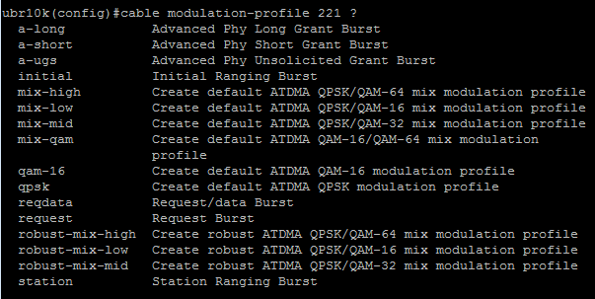
interface Bundle1 ip address 10.15.0.1 255.255.0.0 secondary ip address 10.0.0.1 255.255.0.0 cable dhcp-giaddr policy cable helper-address 172.33.55.10 cable-modem cable helper-address 172.33.55.10 host arp timeout 180
cable spectrum-group 1 band 25000000 65000000 cable modulation-profile 223 robust-mix-low

Slide 58
interface Cable5/0/0 downstream Integrated-Cable 5/0/0 rf-channel 0-3 downstream Integrated-Cable 5/0/1 rf-channel 0-3 cable spectrum-group 1 cable tftp-enforce cable mtc-mode
cable upstream bonding-group 100
upstream 0
upstream 1
attributes 80000000 cable bundle 1 cable upstream max-ports 8 cable upstream 0 connector 0 cable upstream 0 channel-width 3200000 3200000 cable upstream 0 power-level 0 cable upstream 0 docsis-mode atdma cable upstream 0 modulation-profile 222 223 cable upstream 0 equalization-coefficient no cable upstream 0 shutdown

Slide 59
interface Integrated-Cable5/0/0:0 cable bundle 1 cable rf-bandwidth-percent 20 remaining ratio 100 !These are the individual downstreams available to docsis 1.x and 2.0 CM
There is also 20% of bandwidth reserved for non docsis 3.0 modems
so 40% of each channel is reserved (20% for docsis 3.0 and 20% for non docsis 3.0) the remaining 60% of the channel is available to either type of modem in a first come first serve basis
The only reason to reserve bandwidth is if you applications like packetcable voice. Such flows require "reserved bandwidth" and will not come up unless there is sufficient reserved capacity.
For example if you are running G.711, you probably need to budget around 100Kbps per voice call. If dont reserve enough bandwidth on your integrated-cable interfaces, your first X number of calls will work, but then when you hit X+1, the new calls will fail.

Slide 60
interface Wideband-Cable5/0/0:0 description „8x" cable bundle 1 cable rf-channel 0 bandwidth-percent 20 remaining ratio 100 cable rf-channel 1 bandwidth-percent 20 remaining ratio 100
cable rf-channel 2 bandwidth-percent 20 remaining ratio 100
cable rf-channel 3 bandwidth-percent 20 remaining ratio 100
cable rf-channel controller 1 channel 0 bandwidth-percent 20 remaining ratio 100
cable rf-channel controller 1 channel 1 bandwidth-percent 20 remaining ratio 100
cable rf-channel controller 1 channel 2 bandwidth-percent 20 remaining ratio 100
cable rf-channel controller 1 channel 3 bandwidth-percent 20 remaining ratio 100 ! this is the downstream for docsis 3.0 modems !notice they have 8 downstreams so will bond to all 8
! bandwidth-percent 20 remaining ratio 100 which means
! reserve 20% of this rf-channel for docsis 3.0 traffic only,
if there is remaining available bandwidth use up to 100% of it for docsis 3.0 Traffic

Slide 61
cable fiber-node 1 downstream Integrated-Cable 5/0/0 rf-channel 0-3 downstream Integrated-Cable 5/0/1 rf-channel 0-3 upstream Cable 5/0 connector 0
Plant Topology
–In DOCSIS 3.0 it is mandatory that the plant topology (fiber nodes and how they are split/combined) is configured in the CMTS
Resolution
An efficient process for determining which FN a CM is physically connected to (or more precisely which downstream physically connected to (or more precisely, which downstream service group its connected too) is possible thanks to the fact that plant topology is reflected in the MDD
snmp-server community albismart RO snmp-server enable traps tty snmp-server manager

Slide 62
Load Balancing
If X customers on single node exceeds capacity of single US or DS, operator must take action:
Split Node – expensive
Add more US/DS channels – load balancing is needed
Static ( Cfg-DS Frequency setting – US channel ID)- Rearrange
Dynamic Load Balancing (Commands from CMTS direct CM to specific US-DS (Vendor algorithm)
cable load-balance group 1 method utilization cable load-balance group 1 dcc-init-technique 4 cable load-balance group 1 threshold load 10 enforce 20
Int ca5/0/0
Cable load-balance group 1
Nachfolgend:
Übersicht & Details DOCSIS 3.1
Notes:
0-5 Different modes of move called initialization techniques exist. ( longest interruption of service – re-initilization and ranging and without any QoS reservation on the new channel to the least interruption of service ( without re-initialization or ranging .
Load balancing is manageable on a per-cm basis. The CMTS assigns each CM :
To a set of channels ( a Load balancing group) amonth which it can be moved by the cmts
A policy which governs if and when the cm can be moved
A priority value which can be used by the cmts in order to selects cms to move .

Slide 63
! here's the docsis1.x and 2.0 load balancing group
cable load-balance docsis-group 5040
downstream Integrated-Cable 5/0/4 rf-channel 0-3
upstream Cable5/0/4 0-1
init-tech-list 1-4 ucc
method modems
! 4DS+2US-load-bal by downstream bandwidth utilization. cable load-balance docsis-group 10
downstream Integrated-Cable 5/1/4 rf-channel 0-3
upstream Cable1/0 0-3
method utilization
threshold load 50
policy pure-ds-load
init-tech-list 4
! here is the docsis 3.0 load balancing group
! this is basically upstream load balancing only because docsis 3.0 modems will be locked to all downstreams simultaneously
cable load-balance docsis-group FN 33 MD Cable5/0/4
method modems
cable load-balance docsis-group FN 2 MD Cable1/1
method utilization
interval 60
threshold load 50
policy pure-ds-load
init-tech-list 4
Notes:
There are two different types of docsis load balancing groups one in the style
! for docsis 1.x and 2.0 modems
! can load balance down and upstream
cable load-balance docsis-group 11
! for docsis 3.0 modems
! only load balances upstream because docsis 3.0 can see all the downstreams simultaneously
cable load-balance docsis-group FN 2 MD Cable1/0
They work together and can definitely be used on the same physical downstream and upstream ports
!To get your docsis 3 modems to register as docsis 3 modems use
cable wideband auto-reset

Slide 64
cable load-balance docsis-enable
cable load-balance docsis30-enable
cable load-balance docsis30-enable dynamic downstream
cable load-balance modem max-failures 2
cable load-balance method-utilization min-threshold 60
cable load-balance rule 1 disable-thoughput-lowerbound us 100
cable load-balance rule 2 disable-throughput-lowerbound ds 500
cable load-balance docsis-policy 1 rule 1
cable load-balance docsis-policiy 1 rule 2
Cable load-balance docsis-group 10
Downstream Integrated-Cable 5/1/4 rf-channel 0-3
Upstream Cable1/0 0-3
Method utilization
Threshold load 15
Policiy pure-ds-load
Init-tech-list 4
Docsis-policy 1
cable, integrated, modular, wideband
Load-interval 30

Slide 65
Troubleshooting
Show cable modem
Show cable mac-domain cable 6/0/0 rcc
Show cable modem primary-channel sum tot
Show controller cable 6/0/0 upstream 0
show cable modem wideband registered-traditional-docsis
show cable urm
Show run all

Slide 66
Troubleshooting Upstream Channel Bonding
CMTS considerations:
–Is DSCB configured? USCB requires DSCB
–Are the US assigned to an USBG?
–Are the US configured correctly and Are the US configured correctly and
–no shut?”
–What MTC-mode are you using?
cfg considerations : –Do you need a required attribute mask?
–Is the attribute in the CM bin file?
–Does the USBG have the correct channels?
Modem/Plant/Subscriber side considerations:
–Is there too much attenuation in the US RF path?

Slide 67
Recomandation
Cable modem max-cpe 10
Limit Number of CPE hosts associated per CM
Prevent attackers from obtaining very large amount of IP addresses
D30 DS VOIP is bonded, which may cause DS latency or jitter
Place voice call service flows on primary downstream with
Cable docs30-voice downstream req-attr-mask 0 forb-attr-mask 80000000
Upstream Voice traffic is never bonded, nor are other scheduled flows

Slide 68
Questions & Discussion
Experience with load balancing?
What modulations and your experiences on the net?
Typical RF problems to date?
How is measured (VIAVI DSAM & SDA5500 ?, etc.)?
Experiences / problems with cable modems?
Did you think about Fttx?
TV Injection
Etc.
Overview & Details DOCSIS 3.1

